Slide 1
Introduction to Operating System
ESHAN COLLEGE OF ENGINEERING, MATHURA

Slide 2
ESHAN COLLEGE OF ENGINEERING, MATHURA
What is an Operating System?
A program that acts as an intermediary between a user of a computer and the computer hardware
Operating system goals:
Execute user programs and make solving user problems easier
Make the computer system convenient to use
Use the computer hardware in an efficient manner
By: Vyom Kulshreshtha
Associate Professor
Computer Science & Engineering

Slide 3
ESHAN COLLEGE OF ENGINEERING, MATHURA
Computer System Structure
Computer system can be divided into four components:
Hardware – provides basic computing resources
CPU, memory, I/O devices
Operating system
Controls and coordinates use of hardware among various applications and users
Application programs – define the ways in which the system resources are used to solve the computing problems of the users
Word processors, compilers, web browsers, database systems, video games
Users
People, machines, other computers
By: Vyom Kulshreshtha
Associate Professor
Computer Science & Engineering

Slide 4
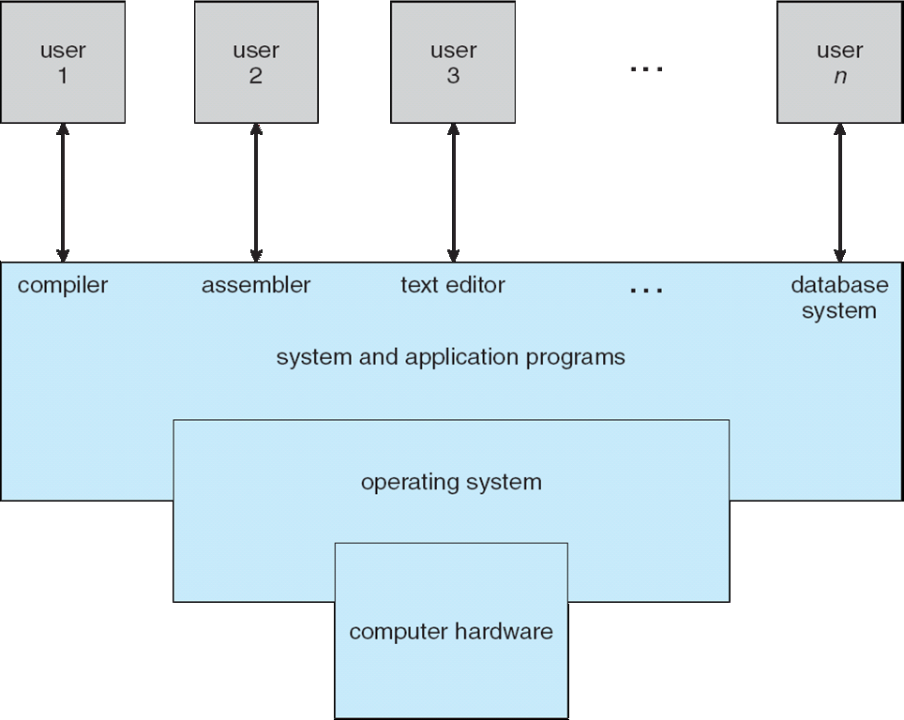
ESHAN COLLEGE OF ENGINEERING, MATHURA
Four Components of a Computer System

Slide 5
ESHAN COLLEGE OF ENGINEERING, MATHURA
What Operating Systems Do
Depends on the point of view
Users want convenience, ease of use and good performance
Don’t care about resource utilization
But shared computer such as mainframe or minicomputer must keep all users happy
Users of dedicate systems such as workstations have dedicated resources but frequently use shared resources from servers
Handheld computers are resource poor, optimized for usability and battery life
Some computers have little or no user interface, such as embedded computers in devices and automobiles
By: Vyom Kulshreshtha
Associate Professor
Computer Science & Engineering

Slide 6
ESHAN COLLEGE OF ENGINEERING, MATHURA
Operating System Definition
OS is a resource allocator
Manages all resources
Decides between conflicting requests for efficient and fair resource use
OS is a control program
Controls execution of programs to prevent errors and improper use of the computer
By: Vyom Kulshreshtha
Associate Professor
Computer Science & Engineering

Slide 7
ESHAN COLLEGE OF ENGINEERING, MATHURA
Operating System Definition (Cont.)
No universally accepted definition
“Everything a vendor ships when you order an operating system” is a good approximation
But varies wildly
“The one program running at all times on the computer” is the kernel.
Everything else is either
a system program (ships with the operating system) , or
an application program.
By: Vyom Kulshreshtha
Associate Professor
Computer Science & Engineering

Slide 8
ESHAN COLLEGE OF ENGINEERING, MATHURA
Computer Startup
BIOS performs POST
bootstrap program is loaded at power-up or reboot
Typically stored in ROM or EPROM, generally known as firmware
Initializes all aspects of system
Loads operating system kernel and starts execution
By: Vyom Kulshreshtha
Associate Professor
Computer Science & Engineering

Slide 9
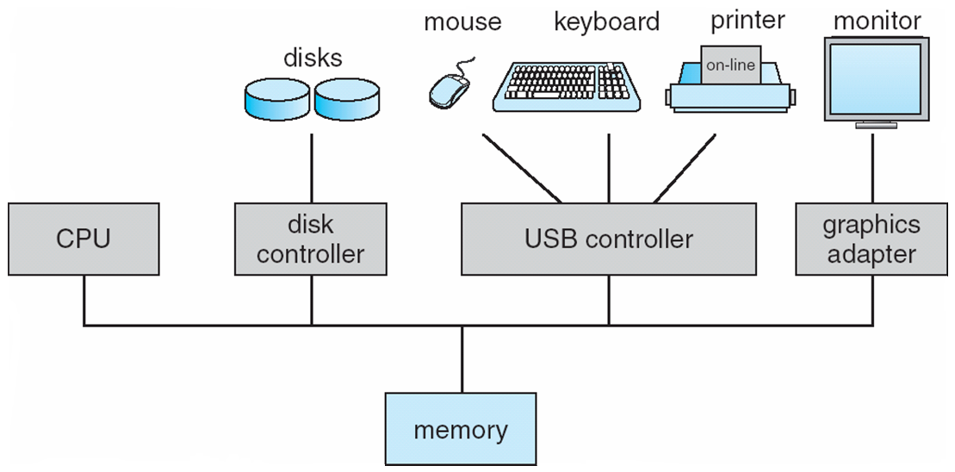
ESHAN COLLEGE OF ENGINEERING, MATHURA
Computer System Organization
Computer-system operation
One or more CPUs, device controllers connect through common bus providing access to shared memory
Concurrent execution of CPUs and devices competing for memory cycles
By: Vyom Kulshreshtha
Associate Professor
Computer Science & Engineering

Slide 10
ESHAN COLLEGE OF ENGINEERING, MATHURA
Computer-System Operation
I/O devices and the CPU can execute concurrently
Each device controller is in charge of a particular device type
Each device controller has a local buffer
CPU moves data from/to main memory to/from local buffers
I/O is from the device to local buffer of controller
Device controller informs CPU that it has finished its operation by causing an interrupt
By: Vyom Kulshreshtha
Associate Professor
Computer Science & Engineering

